Slide 1



GRT INSTITUTE OF
ENGINEERING AND
TECHNOLOGY, TIRUTTANI - 631209
Approved by AICTE, New Delhi Affiliated to Anna University, Chennai
DEPARTMENT OF ELECTRONICS AND COMMUNICATION ENGINEERING
Accredited by NBA, New Delhi
ARDUINO BASED REAL TIME DROWSINESS AND FATIGUE DETECTION FOR BIKERS USING HELMET
Date-(19/05/2023)
Batch No. - III
Present By,
1. Arun Kumar T - 110319106003
2. Dinesh Benjamin M V - 110319106010
3. Umapathy A V - 110319106046
Guided By.
Mr. V. SORNAGOPAL,
Associate Professor,
Department of Electronics and Communication Engineering

Slide 2
CONTENT
OBJECTIVE
ABSTRACT
LITERATURE SURVEY
1.REVIEW PAPER 1
2.REVIEW PAPER 2
3.REVIEW PAPER 3
4.REVIEW PAPER 4
PROBLEM IDENTIFICATION AND FORMULATION
PROPOSED WORK
BLOCK DIAGRAM
EXPLANATION OF BLOCK DIAGRAM
EXPERIMANTAL SETUP
EXPERIMENTAL OUTPUT
CONCLUSION
GRTIET, Department of Electronics and Communication Engineering

Slide 3
OBJECTIVES:
Real-time drowsiness detection: The primary objective of the helmet could be to accurately and reliably detect drowsiness in real-time using EEG signals.
Early warning system: The helmet could be designed to provide an early warning system for individuals who are at risk of falling asleep.
User-friendly design: The helmet should be designed with user comfort and usability in mind.
GRTIET, Department of Electronics and Communication Engineering

Slide 4
ABSTRACT:
Vehicle accidents are rapidly increasing in many countries.
Among many others factors, drowsiness and fatigue are playing a major role in these accidents and systems which can monitor it are currently being developed.
Among them, ELECTROENCEPHALOGRAPHY(EEG) proved to be very reliable.
The conventional vehicle and the vision based detection for drowsiness is very much essential
only when the driver is about to sleep and every so often very late in preventing fatalities on road.
This paper is specially developed to improve the safety of the bikers.
GRTIET, Department of Electronics and Communication Engineering

Slide 5
w
REVIEW PAPER -1
Implementation And Analysis Of Smart Helmet To Prevent From Road Accident
AUTHOR: Amgoth Kishore, Dr. D Subba Rao PG Scholar, Dept. of VLSI & Embedded System, SIET, Hyderabad. Professor and HOD, Dept. of ECE, SIET, Hyderabad.
JOURNAL : IEEE
YEAR OF PUBLISHED : 2017
DESCRIPTION : We have looked into the ongoing patterns in creating Smart Head covering framework. The shrewd head covering framework is utilized to forestall the mishaps in engine two- wheeler and to recognize the two-wheeler mishaps on schedule for health.
DRAWBACKS:
It has No alcohol detection system
Higly energy consumption
GRTIET, Department of Electronics and Communication Engineering

Slide 6
REVIEW PAPER - 2:
IOT based Smart Helmet with Motorbike Unit for Enhanced Safety
AUTHOR : Guntupalli Sireesha
JOURNAL : IEEE
YEAR OF PUBLISHED : 2020
DESCRIPTION : As we know India is second most populated country and has a large youth population, nowadays youth are fond of bikes and because of fashion, they neglect wearing helmet. Because of these, bike accidents are increasing day by day which causes deaths. Major deaths are due to head injuries which can be prevented by wearing a helmet.
DRAWBACKS:
False alarms: The sensors in smart helmets can sometimes give false alarms, for example, detecting a collision that didn't happen or misinterpreting data due to external factors like weather.
Limited Battery Life: IoT-based smart helmets rely on batteries to power the sensors and connectivity. Limited battery life may require frequent charging or battery replacements,
GRTIET, Department Of Electronics and Communication Engineering

Slide 7
REVIEW PAPER - 3
PREVENTING ACCIDENTS BY ENHANCING SMART HELMET USING IOTBASED SMART SYSTEM
AUTHOR: S.Abrar Ahamed
JOURNAL :IEEE
YEAR OF PUBLISHED : 2020
DESCRIPTION :It is very unfortunate to hear news of any accident and if it happens with our dear ones it causes great pain to us. Road accidents are very common in India, whatever the reason may be. Two wheeler accidents happen mostly because of not wearing the helmet or wearing it improperly such as not putting on the buckle belt.
DRAWBACKS:
Cost: Smart helmets are often more expensive than traditional helmets due to the advanced technology and sensors they contain. This can make them less accessible to individuals or companies on a tight budget.
Maintenance: Smart helmets require regular maintenance to ensure that the sensors and other components are functioning properly. If not properly maintained, the helmet may not provide accurate data or fail to work at all.
GRTIET, Department of Electronics and Communication Engineering

Slide 8
REVIEW PAPER - 4
Development of Smart Helmet Using lot Technology for Safety and Accident Detection
AUTHOR: Sterlin Minish
JOURNAL :IEEE
YEAR OF PUBLISHED : 2020
DESCRIPTION :It is The aim of this paper is to determine road accidents are increasing day by day because the riders are not using the helmet and due to consumption of alcohol. In today’s world, huge numbers of people are dying on road accidents. By using smart helmet, the accidents can be detected. The main target of the project is designing a smart helmet for accident avoidance and alcohol detection.
DRAWBACKS:
In this project EEG can’t detected
GRTIET, Department of Electronics and Communication Engineering

Slide 9
PROBLEM IDENTIFICATION AND FORMULATION:
PROBLEM IDENTIFICATION:
Hard to implementation
It is not cost effective
We can't get able update of the driver status.
Data transmission speed is very less compared to IOT technology Cloud updates are not possible
FORMULATION:
A safe 4 wheeler journey is possible which would decrease the head injuries throughout accidents caused from the absence of helmet.
The driver health parameters are continuously monitored
The alert message is getting updated to the important persons.
Additionally reduce the accident rate due to drunken driving.
The Transmission speed of the data is very high..
GRTIET, Department of Electronics and Communication Engineering

Slide 10
PROPOSED WORK
The core element of the model is the arduino board which controls and manages all the functions performed by the other components of the model. The location of the vehicle will be transferred to the cloud page to monitor.
MEMS Sensor will detect the tilt and record the values based on co-ordinate system and sends the signal to the ardunio board. The Gas sensor MQ3 has high sensitivity to alcohol and sends signal to stop the vehicle. This module provides both digital and analog output.
Heart beat and vibration sensor comes into picture when the rider feels any heart problem and accident detecterd. buzzer is used to alert the sound when any problem to the driver.
SOS message can be sent when rider meets with an accident. This is be achieved using android app, sensors, Wifi and Cloud. Cloud send the data to the concerned person through Wifi.The android app analyzes data and performs specific actions.
GRTIET, Department of Electronics and Communication Engineering

Slide 11
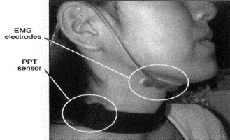
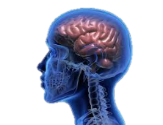
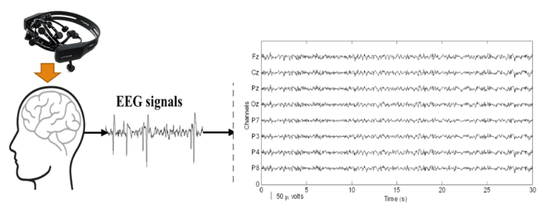
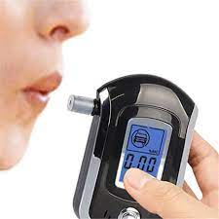
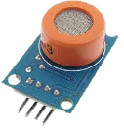
PROPOSED WORK
CONTROLLER UNIT
ALCOHOL DETECTOR
INDICATION
&
IGNISION UNIT OF BIKE
.
GRTIET, Department of Electronics and Communication Engineering

Slide 12
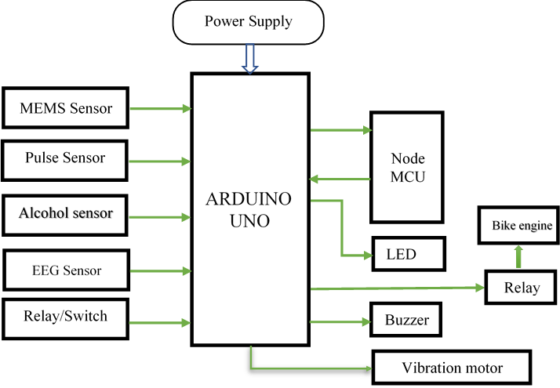
BLOCK DIAGRAM
GRTIET, Department of Electronics and Communication Engineering

Slide 13
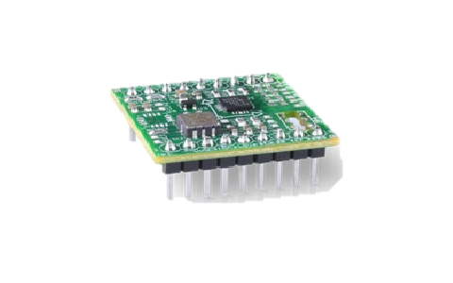
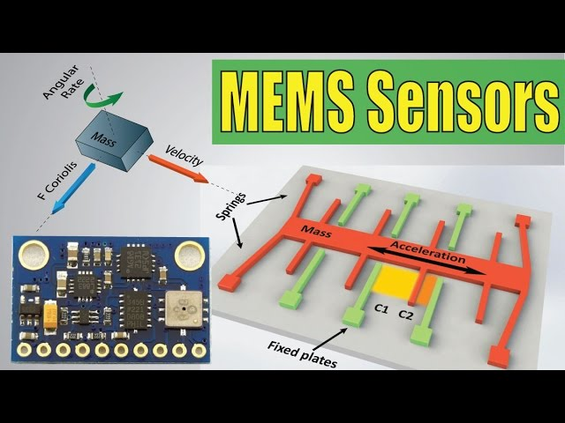
MEMS SENSOR:
MEMS, or Micro Electro-Mechanical System, is a chip-based technology where sensors are composed of a suspended mass between a pair of capacitive plates. When the sensor is tilted, a difference in electrical potential is created by this suspended mass.
Some examples of current MEMS devices include accelerometers for airbag sensors, inkjet printer heads, computer disk drive heads, projection display chips, blood pressure sensors, optical switches, microvalves, biosensors and many other products that are all manufactured in high commercial volumes.
GRTIET, Department of Electronics and Communication Engineering

Slide 14
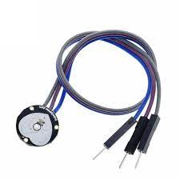
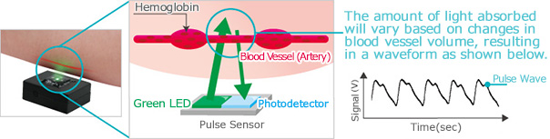
PULSE SENSOR
A pulse wave is the change in the volume of a blood vessel that occurs when the heart pumps blood, and a detector that monitors this volume change is called a pulse sensor.
To Knowing the heart rate data is very helpful while doing exercises, actively studying, etc. But measuring heart rate is a difficult problem. So, a pulse sensor is used to overcome this problem.
GRTIET, Department of Electronics and Communication Engineering

Slide 15
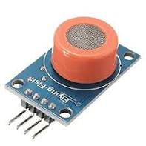
ALCOHOL SENSOR
The alcohol sensor is technically referred to as a MQ3 sensor which detects ethanol in the air.
When a drunk person breathes near the alcohol sensor it detects the ethanol in his breathe and provides an output based on alcohol concentration.
If there is more alcohol concentration more LED's would lit.
GRTIET, Department of Electronics and Communication Engineering

Slide 16
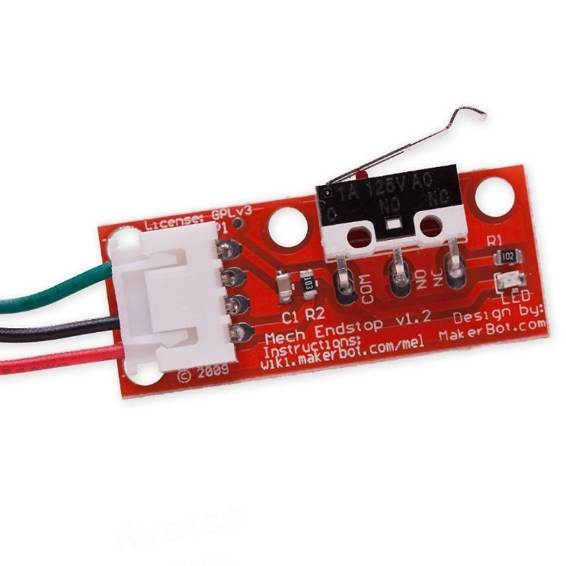
END STOP SWITCH
If an end stop switch is fixed in a helmet to detect a fall, it can provide an additional safety feature by triggering an alert or notifying others when the rider experiences a fall or collision. Here's how such a setup could work:
End stop switch installation: The end stop switch is securely mounted within the helmet, ideally in a position where it can detect sudden movements or impacts. This can be achieved by attaching the switch to the internal structure of the helmet or integrating it into the padding or lining.
GRTIET, Department of Electronics and Communication Engineering

Slide 17
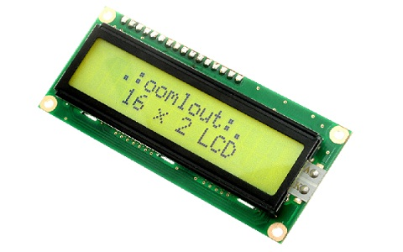
LCD
The liquid crystal display (LCD) panel is designed to project on-screen information of a microcomputer onto a larger screen with the aid of a standard overhead projector
Parameter | Value
Operating Voltage | 4.7V-5.3V
Operating Current | 1mA with no backlight
Controller | HD47780
Number of columns | 16 each row, total 16 x2 = 32 columns
Number of rows | 2
Number of Character | 32
Character font-size | 0.125″W x 0.200″H
Work Modes | 4-bit & 8-bit
Backlight LED color | Blue or Green
Number of Pins | 16
Module PCB Size | 80 x 36 x 10 (LxWxH) mm.
GRTIET, Department of Electronics and Communication Engineering

Slide 18
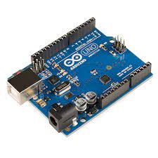
AURDINO
It is an aurdino powered EEG machine, also known as Electroencephalography machine.
Now normally these will cost you lots of money and are hard to understand without a degree in neuro science, but this aurdino version is much cheaper and easier! So you might be asking...
What does it do? In short it reads brainwaves that are created by your brain.
This allows us to tell how much a person is paying attention or if he/she is deppressed or in an emotional state.
GRTIET, Department of Electronics and Communication Engineering

Slide 19
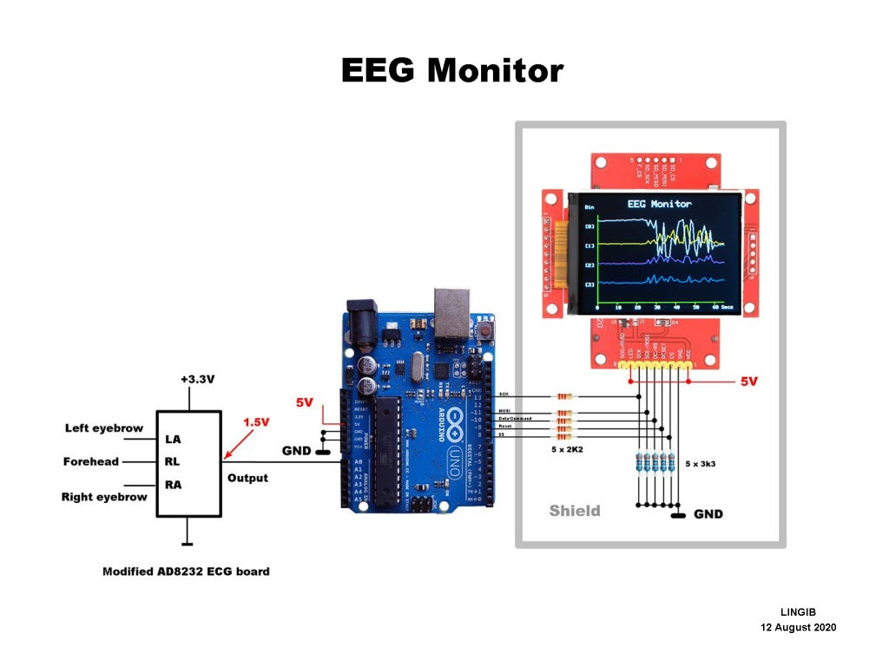
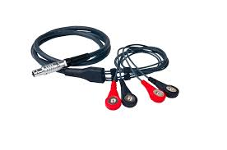
EEG MONITERING SENSOR
An EEG is a test that detects abnormalities in your brain waves, or in the electrical activity of your brain.
During the procedure, electrodes consisting of small metal discs with thin wires are pasted onto your scalp.
The electrodes detect tiny electrical charges that result from the activity of your brain cells.
The charges are amplified and appear as a graph on a computer screen, or as a recording that may be printed out on paper. Your healthcare provider then interprets the reading
GRTIET, Department of Electronics and Communication Engineering

Slide 20
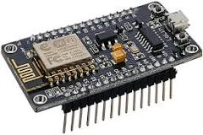
NODE MCU
The NodeMCU (Node MicroController Unit) is an open-source software and hardware development environment built around an inexpensive System-on-a-Chip (SoC) called the ESP8266.
NodeMCU is an open source firmware for which open source prototyping board designs are available. The name "NodeMCU" combines "node" and "MCU" (micro-controller unit). Strictly speaking, the term "NodeMCU" refers to the firmware rather than the associated development kits.
GRTIET, Department of Electronics and Communication Engineering

Slide 21
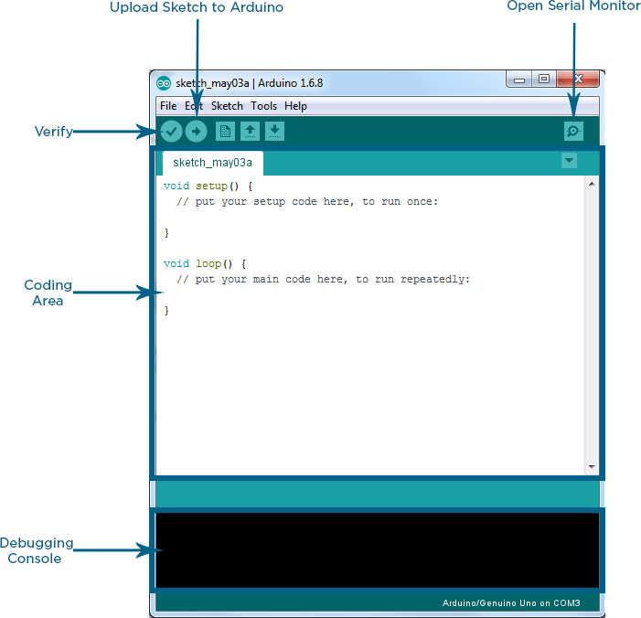
SOFTWARE REQUIREMENT
Arduino IDE:
Arduino IDE is an open source software that is mainly used for writing and compiling the code into the Arduino Module.
It is an official Arduino software, making code compilation too easy that even a common person with no prior technical knowledge can get their feet wet with the learning process.
GRTIET, Department of Electronics and Communication Engineering

Slide 22
EXPERIMENTAL SETUP
The experimental setup for the Arduino-based real-time drowsiness and fatigue detection system for bikers using a helmet includes various components that are connected to the Arduino board and programmed using the Arduino IDE.
The system is powered using a battery or by connecting it to the bike's electrical system and can monitor the biker's eyelid and head movements in real-time. It provides alerts if the biker is becoming drowsy or fatigued, and can also adjust the position of the helmet visor as needed to improve visibility and reduce glare.
Additionally, the system can upload the data to the cloud using NodeMCU, where it can be analyzed and used to further improve the system's accuracy and performance.
GRTIET, Department of Electronics and Communication Engineering

Slide 23
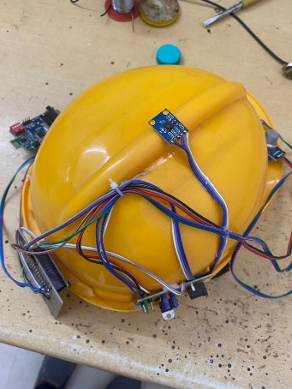
EXPERIMENTAL SETUP
GRTIET, Department of Electronics and Communication Engineering

Slide 24
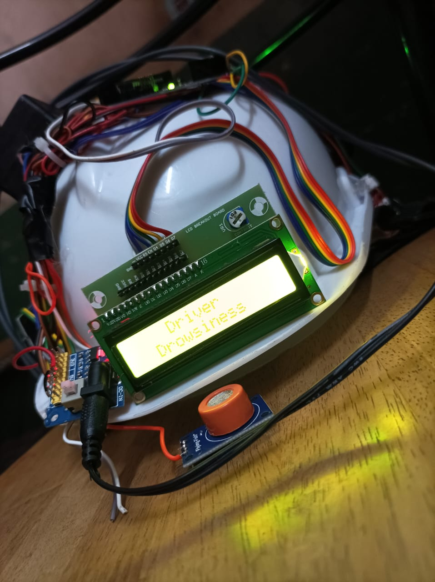
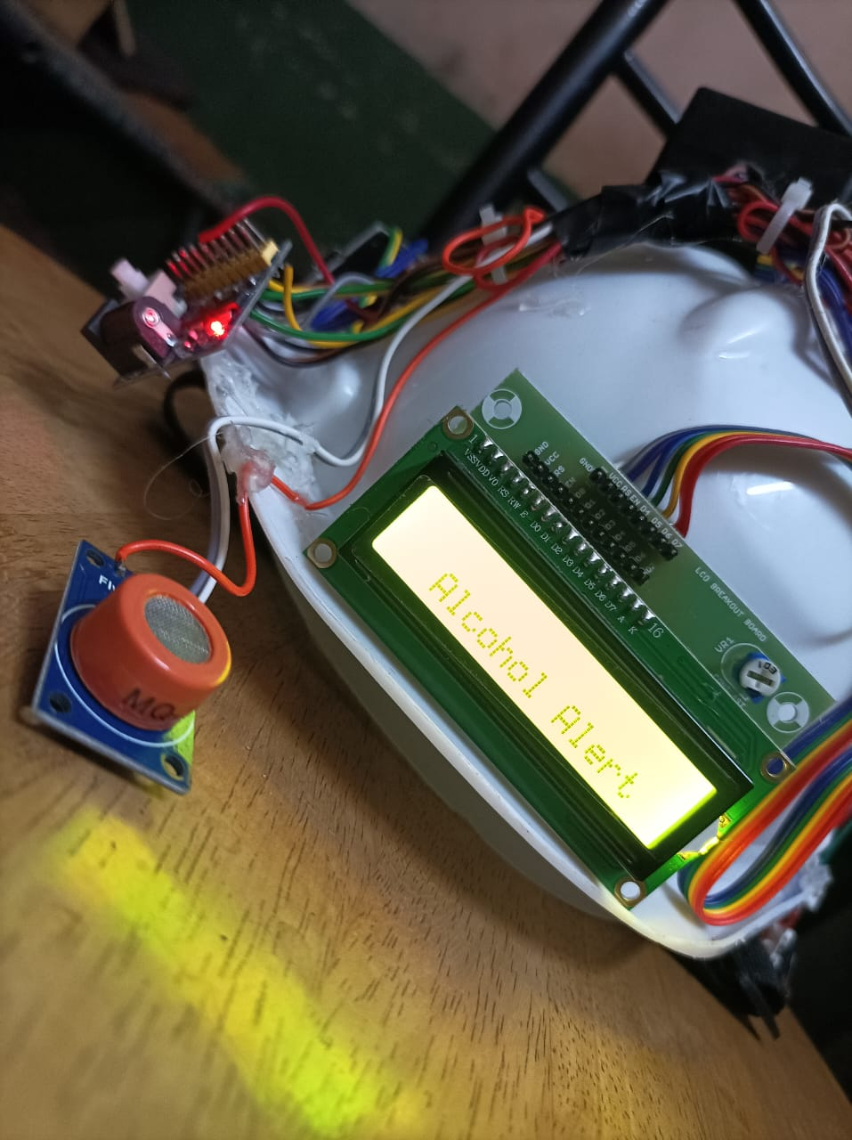
EXPERIMENTAL RESULT
GRTIET, Department of Electronics and Communication Engineering

Slide 25
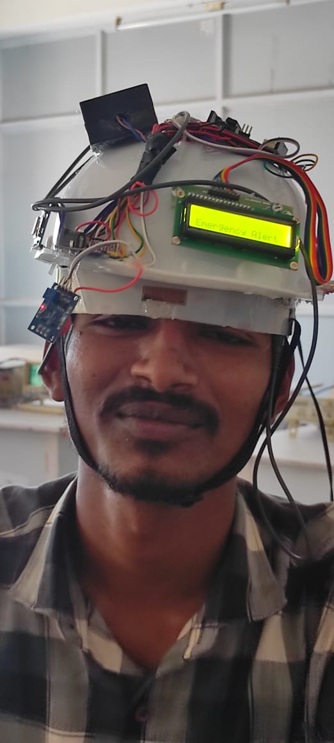
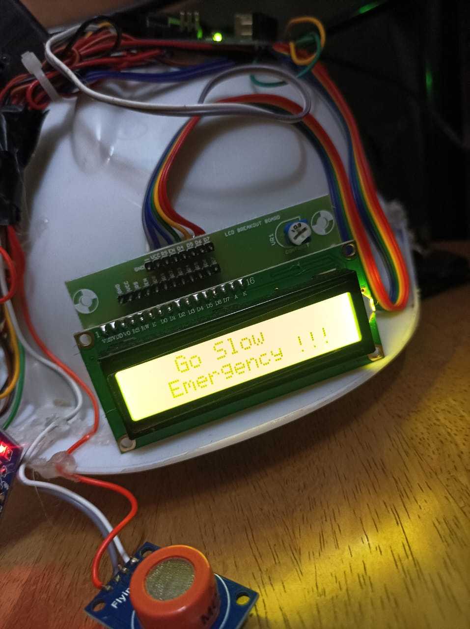
EXPERIMENTAL SETUP
GRTIET, Department of Electronics and Communication Engineering

Slide 26
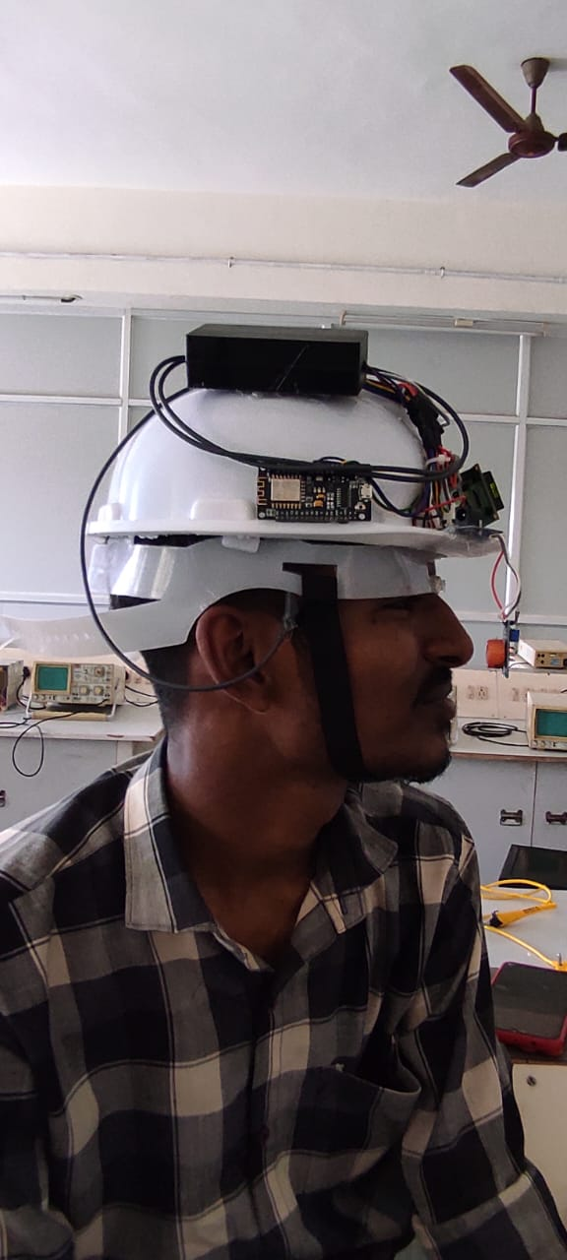
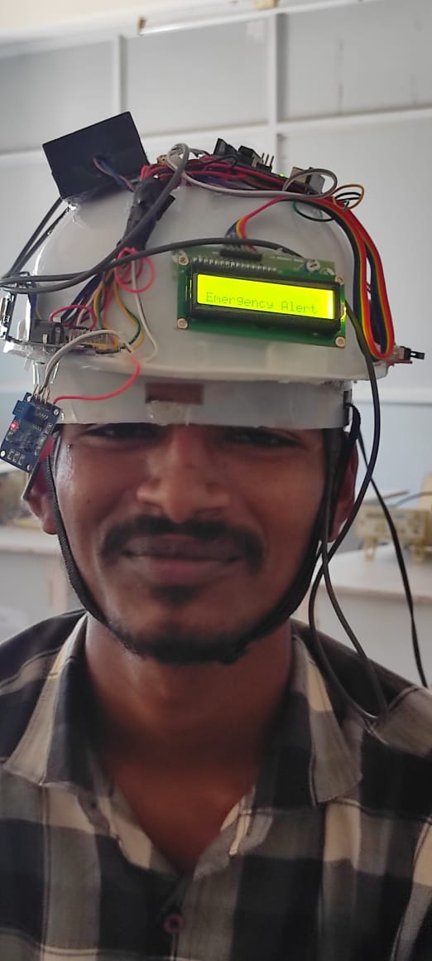
EXPERIMENTAL SETUP
GRTIET, Department of Electronics and Communication Engineering

Slide 27
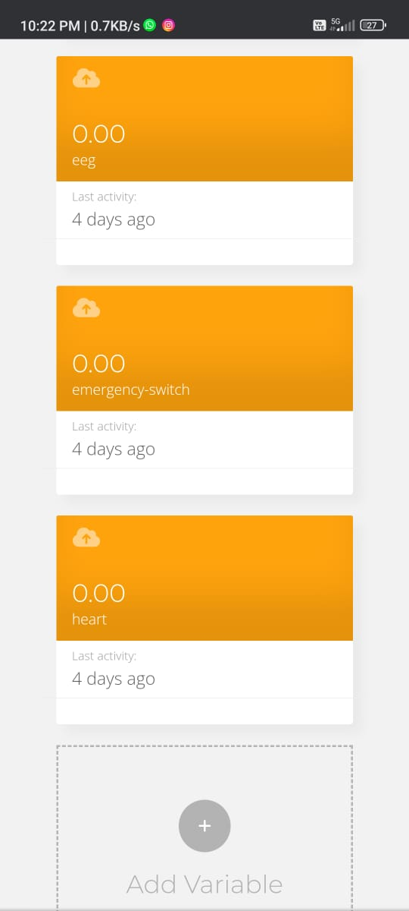
WEB APPLICATION
The Gathered Information's Are Shown In The Below Web Application.
Web Application name: UBIDOTS
GRTIET, Department of Electronics and Communication Engineering

Slide 28
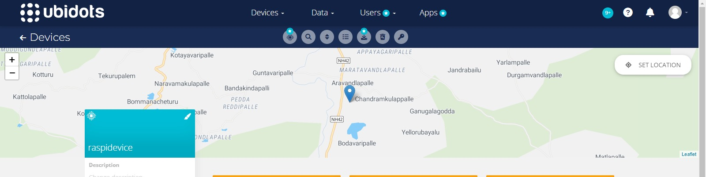
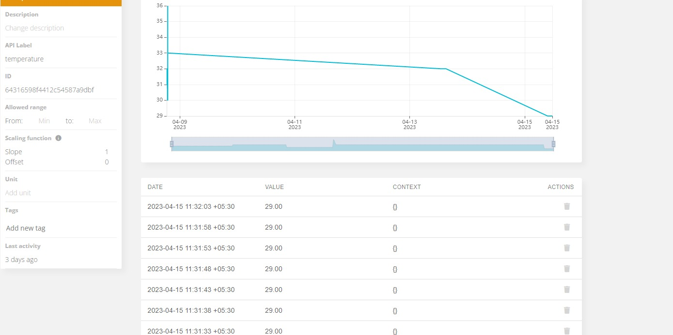
SOFTWARE OUTPUT
GRTIET, Department of Electronics and Communication Engineering

Slide 29
CONCLUSION
The driver drowsiness and alcohol detection system is used to detect the drowsiness of the driver and also detects the alcohol consumption of driver. If there is drowsiness or consumption then the motor of the car gets slowed down and the buzzer sounds until the eyes gets opened. The values of alcohol and the blink rate will be displayed in the serial monitor of the Arduino IDE IOT for intimate the parents or family member. This proposed system helps in finding drowsiness and alcohol detection using Arduino. This helps in avoiding many accidents. Further we extend this project by using webcam to detect the drowsiness of the driver.
GRTIET, Department of Electronics and Communication Engineering

Slide 30
REFERENCE
[1] Elzohairy Y (2008) Fatal and injury fatigue-related crashes on ontario’s roads: a 5-year review. In: Working together to understand driver fatigue: report on symposium proceedings, february 2008
[2] Dingus TA, Jahns SK, Horowitz AD, Knipling R (1998) Human factors design issues for crash avoidance systems. In: Barfield W, Dingus TA (eds) Human factors in intelligent transportation systems. Lawrence Associates, Mahwah, pp 55–93.
[3] Idrees, H., Warner, N., and Shah, M. (2014). Tracking In Dense Crowds Using Prominence And Neighborhood Motion Concurrence. Image And Vision Computing, 32(1):14–26. Yamamomo K, Higuchi, S Development of a drowsiness warning system. J, SocAutomotEng Jap 46:127–133
[4].K.C.Yowand,R.Cipolla,“FeatureBasedhumanfacedetection,“ImageVisio nComput., vol.15, no.9, 1997,pp.713–735.
[5].An Analysis of Viola Jones algorithm for face detection by Yi- QuinWang, University of Malaysia Phang, 2014,pp:15-20.
[6].Implementation of Voila Jones Algorithm by Ole HelvigJensen, university of Denmark, 2008, pp:20-36.
GRTIET, Department of Electronics and Communication Engineering

Slide 31

ANY QUERIES…
GRTIET, Department of Electronics and Communication Engineering

Slide 32
THANK YOU
GRTIET, Department of Electronics and Communication Engineering

